Slide 1
Live Forensics
现场取证

Slide 2
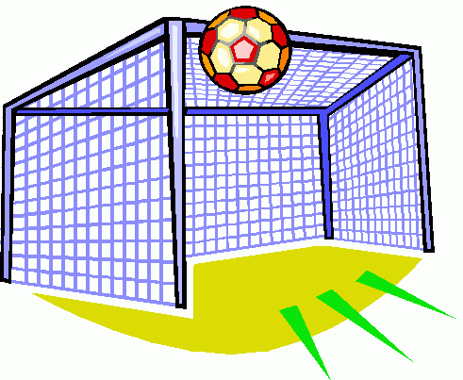
Goals
现在发生了什么
  重建会话（例如，Web、ftp、telnet、IM）
  查找文件（通过网络驱动器下载或访问）
  查找密码
  识别远程计算机
谁在做什么
获得有用的片段信息
帮助集中静态分析（磁盘的哪些部分）
获取密码、未加密数据等。
信息可用于：

Slide 3
Why Live Forensics?
Big disks
  磁盘容量不断增加
最短停机时间
更难查封系统（即使有法院命令）
为静态分析提供上下文
低调检查
数据生命周期长
某些数据仅在内存中
  TB级系统庞大而常见
  搜索（或索引）需要时间
  镜像需要时间
Notes:
Low-profile 低调

Slide 4
Why: The Lifetime of Volatile Data
Chow (“Shredding your Garbage” paper)
易失性数据的生存期
  用户名
物理内存的取证分析揭示了“私人”数据，即使在使用几周后
既是取证问题，也是隐私问题
  密码/加密密钥
  信用卡号
  私人对话
  …

Slide 5
Lifetime (2)
大多数当前系统不采取任何步骤来覆盖内存中的敏感数据
  Financial data, medical records, lists of passwords
在网络浏览器中输入的密码可能会重复数十次
  kernel buffers, window manager, application buffers, dynamic memory allocator
如果软件崩溃，核心转储可能会泄露此信息
实时取证分析可以在上次使用数月后揭示敏感数据
大多数处理敏感数据的应用程序并不是专门为处理敏感数据而设计的
e.g., Word processors:

Slide 6
Chow: Data Lifetime
理想生命期：数据实际使用的时间段
  first write after allocation → last read before deallocation
自然生命期：数据保持可读的时间段
  first write after allocation → first write after reallocation (first overwrite)
安全释放生命期：解除分配时为零
  first write after allocation → deallocation (when it is zeroed)

Slide 7
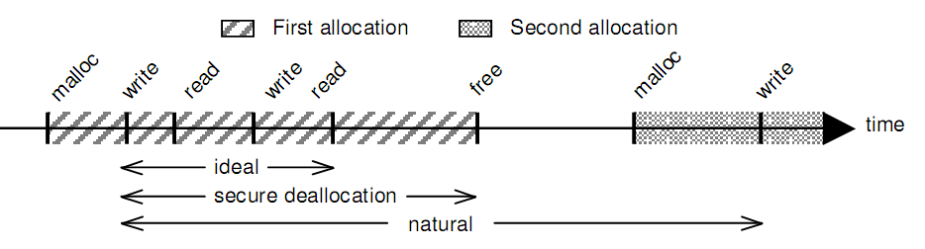
Chow: Data Lifetime
Notes:
理想的生命期：从写到最后一次读时段，清零；安全回收生命期：从写到回收时段，清零；自然生命期：从写到被覆盖时段

Slide 8
Lifetime Experiment
Linux machine, 1GB RAM
Windows machine, 1GB RAM
Linux server, 256MB RAM
Linux version of experiment:
  64MB buffer filled with 20 byte “stamps”
  Allocate and release
  Each stamp:
    magic number, serial number, checksum
Windows version:
  4MB buffer transmitted between machines

Slide 9
Lifetime Experiment (2)
Immediately after allocation:
  2-4MB of stamps remain
14 days later:
  23KB – 3MB of stamps remain
Additional 14 days on Linux server:
  7KB of stamps remain
Most remaining stamps “trapped” in blocks of memory in the kernel slab allocator
Reboot on Thinkpad T30 laptop: stamps remain after 30 seconds w/o power

Slide 10
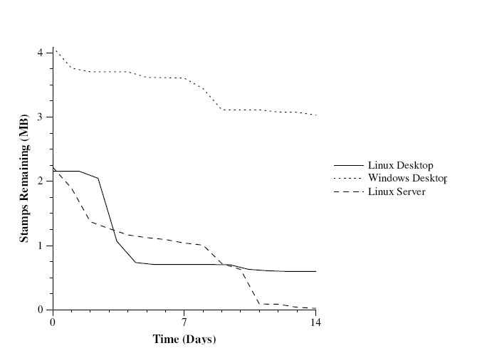
Lifetime Experiment (3)

Slide 11
Persistence of (Post-Reboot) Memory
在新奥尔良大学和纽约ATC进行的研究
许多系统在热重启、重置甚至冷重启后至少保留一些数据
高度依赖于型号和 BIOS 设置
作为获取实时取证数据的“最后手段”可能很有用，假设已知计算机模型具有重新启动后的持久内存
Notes:
Persistence留存

Slide 12
现场取证：风险
大多数实时取证工具都依赖于操作系统来提供一些基本服务
  Reads of physical memory
  Disk dumping
用户级 rootkit
  简单的欺骗
  修改系统命令（例如，ls、ps、du、df）
  更改磁盘空间统计信息、正在运行的进程列表等。
Notes:
Dangers风险，危险 Shallow trickery 浅弄虚作假。用户级：使用虚假的程序。Rootkits恶意程序，隐藏文件、进程、通信

Slide 13
Live Forensics: Dangers (2)
内核级 rootkit
  深层次的欺骗
磁盘驱动程序
替换共享库
  Affects even your “trusted” executables unless they’re statically linked!
黑客虚拟内存系统
  修改操作系统以产生任意结果
  允许文件、物理内存块等。即使使用受信任的可执行文件也会隐藏
Notes:
内核级：使用可信的执行程序，但OS被修改了，提供了虚假结果。

Slide 14

最大限度地减少更改和人造物
  analogy to physical data
  must balance tool footprint to usefulness
及时获取和分析证据
需要访问系统
需要尽量减少对系统的影响，特别是如果它是“关键任务”
Notes:
analogy to physical data类比 usefulness 效能。12-17页

Slide 15
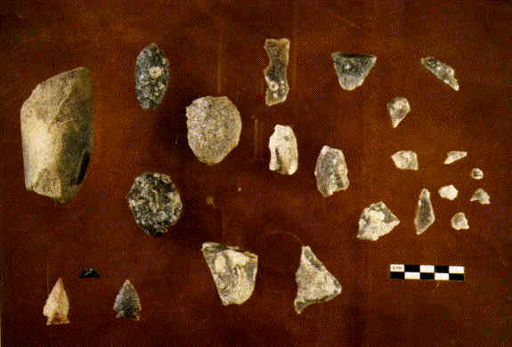
Minimize Changes and Artifacts
Small footprint (using trusted software)
Try not to change anything
  But everything changes, all the time
  Minimize changes to evidence
  Record all steps taken and artifacts
Low profile, minimize detection
Artifacts can be explained
  analogy: detective’s finger-
  prints on ransom note
Notes:
ransom note勒索信

Slide 16

Timely Evidence Acquisition and Analysis
First response/triage
Looking for evidence, or for what computers, disks, directories, etc. may contain evidence. Examples:
  30 servers, search warrant says image 1
  search warrant for quick hash scan to find sufficient cause to get a broader warrant
Looking for context for static analysis

Slide 17
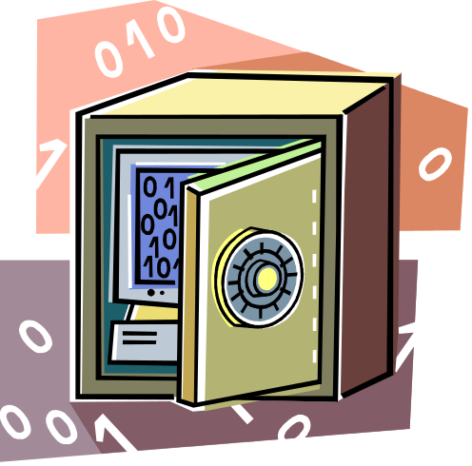
Need Access to the System
调查前
  Use preinstalled agents
  Requires prior access (plan to be attacked?)
  Agents must not have become compromised
调查期间
  Need credentials for log-in
  Must use known good binaries
  See previous on artifacts
Notes:
binaries二进制文件

Slide 18
典型场景
分类/快速浏览
  Machine running slow
  Lots of “suspicious” disk or network activity
证明更大范围的许可证是合理的
正在进行的犯罪（进行中）
运行非法服务器
特洛伊木马防御（支持/反驳）
这台机器是怎么回事？
Notes:
Triage伤员拣别分类,治疗类选法（根据紧迫性和救活的可能性等在战场上决定哪些人优先治疗的方法）

Slide 19
Scenario: Triage
时间有限。 想回答:
  Is there a problem?
  What machine(s) are affected?
  What disks need to be imaged?
  What is running on the system?
专注于问题最严重和证据最丰富的地方

Slide 20
Scenario: Justify Warrant
无中断、快速的哈希搜索
  Look for the presence of a file or tools
  Match against known hashes
  Look for email addresses, etc.
调查员不会关闭机器、中断服务或引起怀疑
调查员看不到实际文件
如果合理，可以返回进行全面调查
证据损坏的风险，必须小心
Notes:
raise suspicion 引起怀疑 justified 有道理的, 合乎情理的Non-disruptive不制造混乱的

Slide 21
Scenario: Ongoing Crime
想“在行动中”抓住他们
  他们是如何进入的
  他们侵害了什么
  他们在哪里
  他们是谁
显示事物如何变化（网页、文件访问时间、注册表、内存等）
Want to understand:

Slide 22
Scenario: Illegal Server
Compare what’s running on the machine and what ports are open to a network scan (e.g., nmap et al)
What services does the world see visible on the computer?
Some techniques are subtle (“port knocking”), but most are not端口碰撞
Look at network traces to see who is talking to the computer (be careful of legal issues)
Notes:
运行非法服务器查看服务器行为，Port knocking is a stealthy network authentication system that uses closed ports to carry out identification of trusted users.
In computer networking, port knocking is a method of externally opening ports on a firewall by generating a connection attempt on a set of prespecified closed ports. Once a correct sequence of connection attempts is received, the firewall rules are dynamically modified to allow the host which sent the connection attempts to connect over specific port(s).端口碰撞技术是一种允许访问预先配置好“碰撞”的防火墙服务的技术。所谓的碰撞是由一个尝试访问系统上关闭端口的序列组成。这些尝试要么记录在一个日志中，要么保存在一个后台进程中，通过预先配置这个日志或者进程来监视打开相应端口的序列，如果尝试序列与预先设置的序列相符合，就可以打开某个端口。例如，服务器可以这样设置，在它按顺序接收到与端口2033、3022、6712、4998、以及4113的连接尝试后，打开TCP端口22。

Slide 23
Scenario: Trojan Defense
“这不是我的错，别人在控制我的电脑!”
Support or refute the claim
  Are there traces of (known) Trojans?
  Are there unusual network connections?
  What is running on the machine (that can be seen)?
  Any indication that something is hidden?
  Enough other evidence/activities to corroborate?
Still new
Still tricky (often Trojans/viruses are present)
Plus, malware is often present that didn’t impact the case in a significant way
Notes:
corroborate 巩固, 确证

Slide 24
Information Available
正在运行的进程
打开文件
网络连接
内存（物理/虚拟转储）
常规磁盘文件

Slide 25
Information Available (2)
Images of entire disk
  Live disk imaging
    (a.k.a. shooting a moving target)
Deleted files
  Live file carving
未加密的文档片段
全盘加密方案的加密密钥
易失性恶意软件的副本（用于反汇编和调查）
Notes:
a.k.a. also known as'

Slide 26
Running Processes
Windows
  Open files
  Open network connections
  Registry activity
  Open DLLs
  …
Unix
  Open files
  Open network connections
  Access to corresponding EXE, even if deleted
  Command line that invoked application
  Environment variables
  …

Slide 27
Memory
Process memory
  Finer-grained than dumping entire RAM
  Easier to make sense of virtual address space for a process than physical memory
  More likely to find contiguous application structures
  Can yield passwords, document fragments, unencrypted documents
Kernel memory
  Search for “hidden” processes
  Evaluate health of kernel
String searches
  Most “brute force” technique

Slide 28

Analysis
What's going on?
Are things not right, processes or files hidden, or disk encryption in use?
What's lingering in memory (a lot) and process memory dumps?
Dumping OS structures
  (e.g., determining which areas of swap space correspond to a particular process)

Slide 29
Process/System Analysis Tools
sysinternals tools for Windows
  FileMon – 实时显示文件系统活动
  PSMon – 实时监视进程/线程创建
  PsFile - 显示远程打开的文件
  PsKill - 按名称或进程 ID 终止进程
  PsInfo - 列出有关系统的信息
  PsList - 列出有关进程的详细信息
  PsLoggedOn - 查看谁在本地和通过共享登录
  PsLogList - 转储事件日志记录
  PsPasswd - 更改帐户密码
  PsService - 查看和控制服务
  PS挂起 - 挂起进程
  句柄 – 显示哪些文件由哪些进程打开
  RegMon – 实时查看注册表活动
  列表DLL – 显示加载的DLL

Slide 30
Process Analysis Tools (2)
ntsecurity.nu:
  Pmdump –给定 pid转储进程内存
  列表驱动程序 – 列出加载的内核驱动程序
  列表模块 – 列出与进程关联的 EXE / DLL
  混杂检测 – 确定网络适配器是否在混杂模式下运行
  还有很多其他的

Slide 31
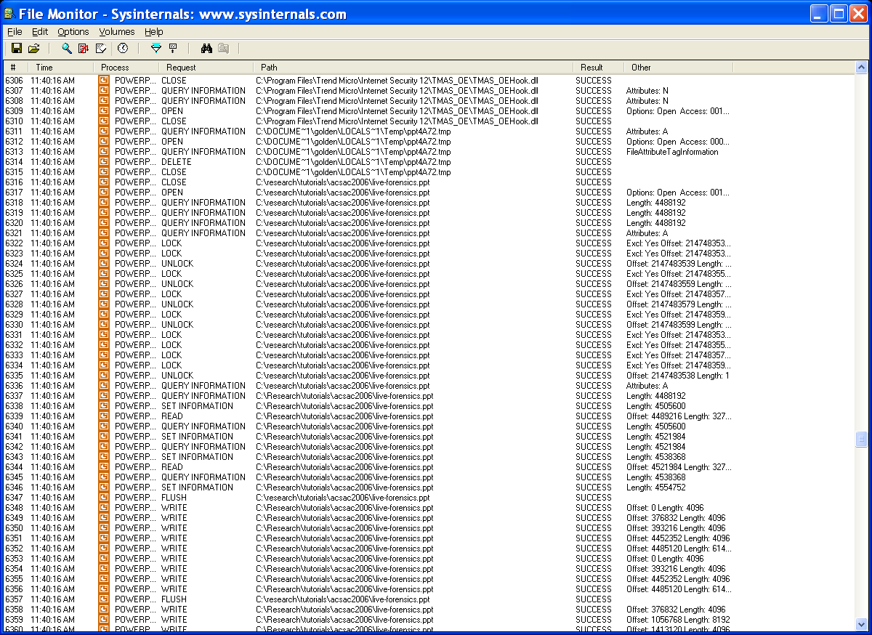
filemon

Slide 32
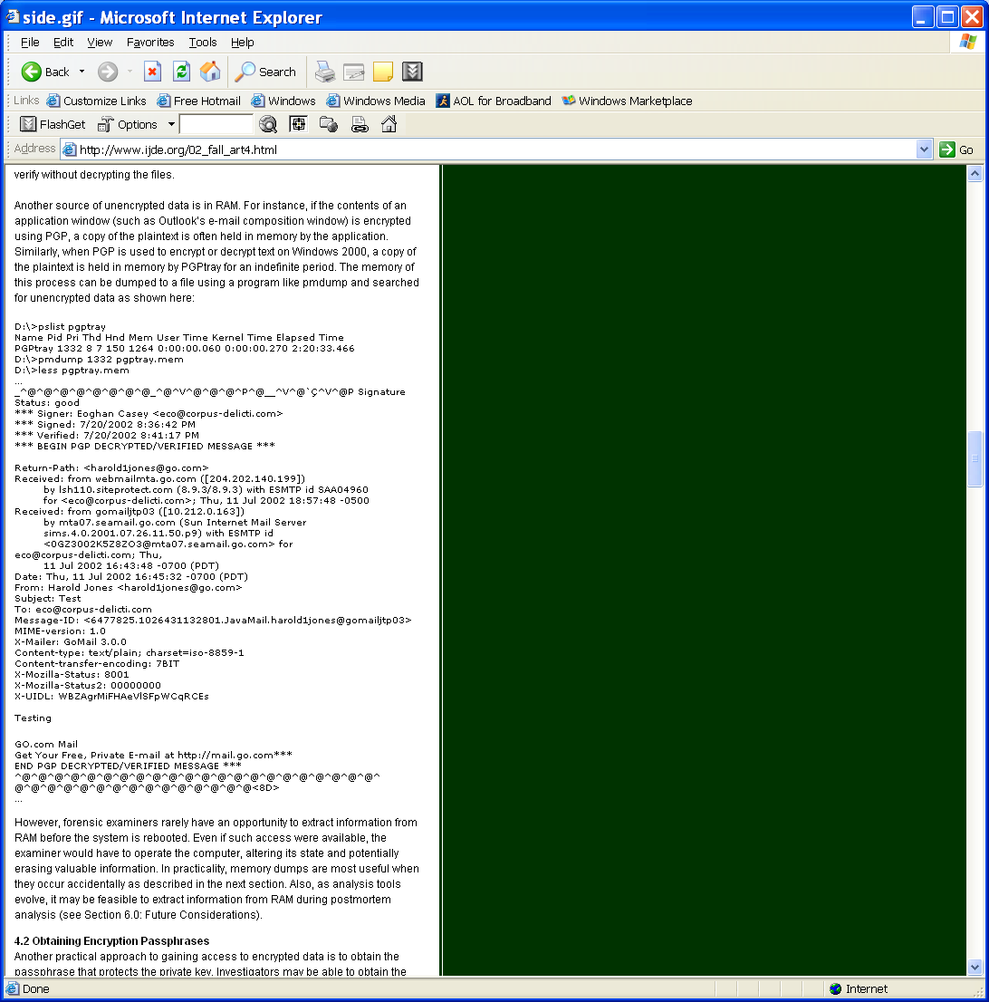
Dump of pgptray
Process info
Mem dump
Plaintext
From: E. Casey, “Practical Approaches to Recovering Digital Evidence”

Slide 33
Integrated Live Analysis Toolset
OnLine Digital Forensic Suite
  Tools for live investigation, data acquisition, and analysis
  Web-based interface

Slide 34
Software-based Acquisition of Physical Memory
dd command
  Under Windows, use \\.\PhysicalMemory device
  (Not usable in user-space in XP SP2 +)
  Under Linux:
    /dev/mem (problematic now)
      Physical memory
    /proc/kcore
      Kernel virtual memory
Problem: must rely on OS to provide physical memory dump
OS might be compromised
After acquisition, interpretation is another issue!

Slide 35
Software-Based (2)
Virtual machines (e.g., VMWare)
  State of a virtual machine, including memory and disk, can be extracted
  Primary drawback is that the “machine” under
  investigation must be a virtual machine
Hibernation files
  Snapshot of physical memory
  Can hibernation process (e.g., writing of physical memory) be subverted?
  Probably. Unaware of available tools to do it now.
Notes:
Sleep, Hibernation,restart,shut down

Slide 36
General Problems with Memory Acquisition
基于软件的存储器镜像解决方案通常需要加载软件
可能会删除一些证据
至少需要对操作系统的有限信任
硬件解决方案通常需要预装卡

Slide 37
Categories for Anti-Acquisition Attacks
拒绝服务攻击
  Crash/Halt machine when somebody tries to acquire RAM
  Can have legal consequences for investigator
覆盖攻击
  Acquisition tool can not read some part of physical memory – instead it reads garbage (e.g. 0x00 bytes).
  CPU sees the real content, which e.g. may contain malicious code and data
完全替换攻击
  Like Covering Attack, but the attacker can also provide custom contents (instead of “garbage”) for the acquisition tool

Slide 38
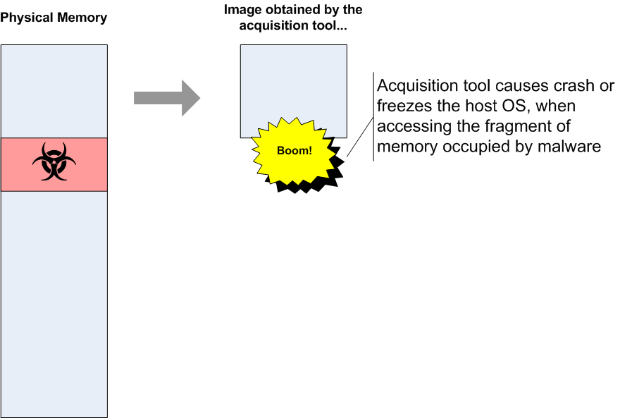
DoS Attack

Slide 39
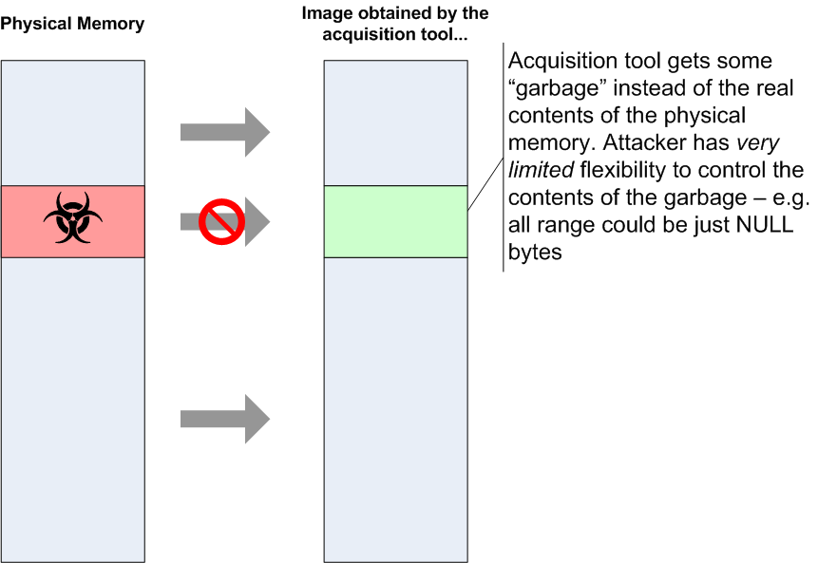
Covering Attack
Notes:
覆盖垃圾，如清零

Slide 40
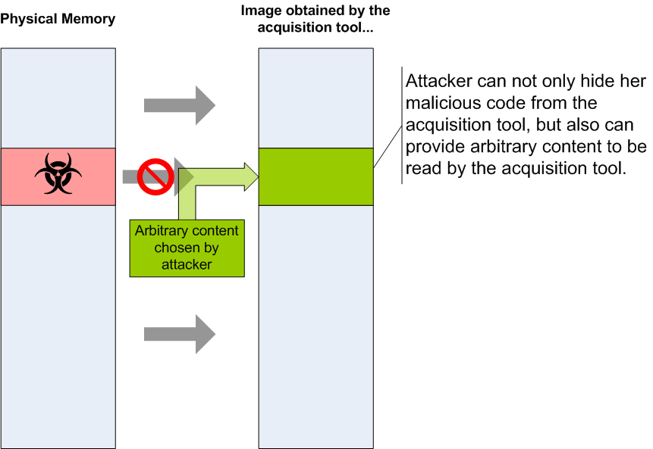
Full Replacement Attack
Notes:
覆盖成可读的内容

Slide 41
Hardware-based Memory Dumping
Hardware-based Memory Acquisition:
  Firewire
    Earlier: Maximillian Dornseif (see references)
    More robust: Adam Boileau (metlstorm), raw1394 stuff
      Security-Assessment / Immunity
  Tribble
    Carrier
Related:
  Copilot: system monitoring
  GPU-based system protection

